Slide 1
Advanced Data Analytics: Basic Evaluation
Professor Ian Nabney
ian.nabney@bristol.ac.uk

Slide 2
Outline
Introduction: what is evaluation for?
Classification with Train, Test, and Validation sets
Handling unbalanced data; parameter tuning
Cross-validation
Comparing machine learning models

Slide 3
Introduction
How much should we believe in what was learned?
Error on the training data (called resubstitution error) is not a good indicator of performance on future data.
Q: Why?
A: Because new data will probably not be exactly the same as the training data!
Overfitting – fitting the training data too precisely – usually leads to poor results on new data.

Slide 4
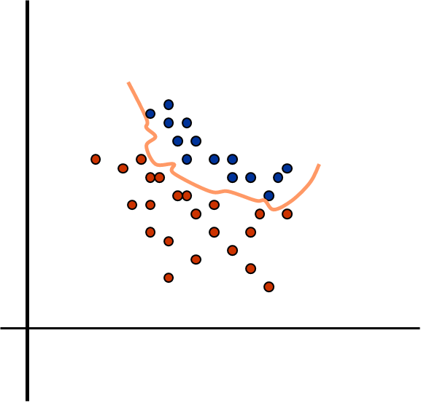
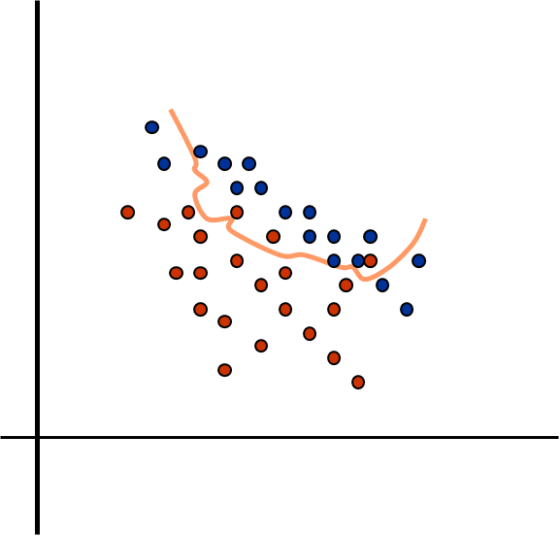
Overfitting
Training Data
Test Data

Slide 5
Purpose of Evaluation
The objective of learning classifications from sample data is to classify and predict successfully on new data.
The true error rate is defined as the error rate of a classifier on an asymptotically large number of new cases that converge in the limit to the actual population distribution (i.e. it is an inherently statistical measure).
The aim of evaluation is to estimate the true error rate using a finite amount of data.

Slide 6
Evaluation issues
Possible evaluation measures:
Classification accuracy (focus on this now)
Total cost/benefit – when different errors involve different costs (we will come back to this later)
Lift and ROC curves
Error in numeric predictions
How reliable are the predicted results (error rate)?
How reliable is our estimate of the true error rate?

Slide 7
Classifier Error Rate
Natural performance measure for classification problems: error rate
Success: instance’s class is predicted correctly.
Error: instance’s class is predicted incorrectly.
Error rate: proportion of errors made over the whole set of instances.
Training set error rate: is way too optimistic!
You can find patterns even in random data.
What is the training set error rate for a nearest-neighbour classifier?

Slide 8
Evaluation on “large” datasets
If many (thousands) of examples are available, including several hundred examples from each class, then a simple evaluation is sufficient.
Randomly split data into training and test sets (usually 2/3 for train, 1/3 for test).
Build a classifier using the training set and evaluate it using the test set. This is an estimate of the true error rate.
Later we shall show how to calculate how accurate the estimate is depending on the size of the test set.

Slide 9
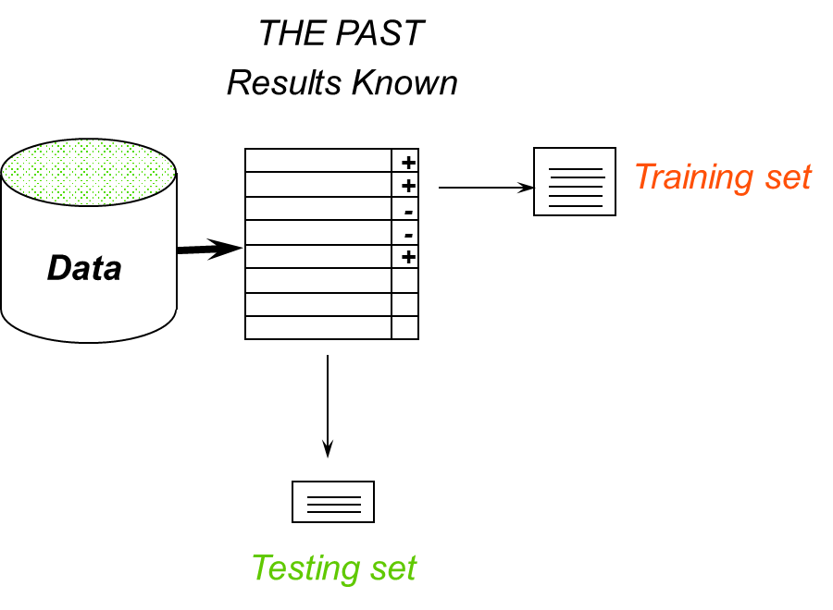
Classification Step 1: split data into train and test sets

Slide 10
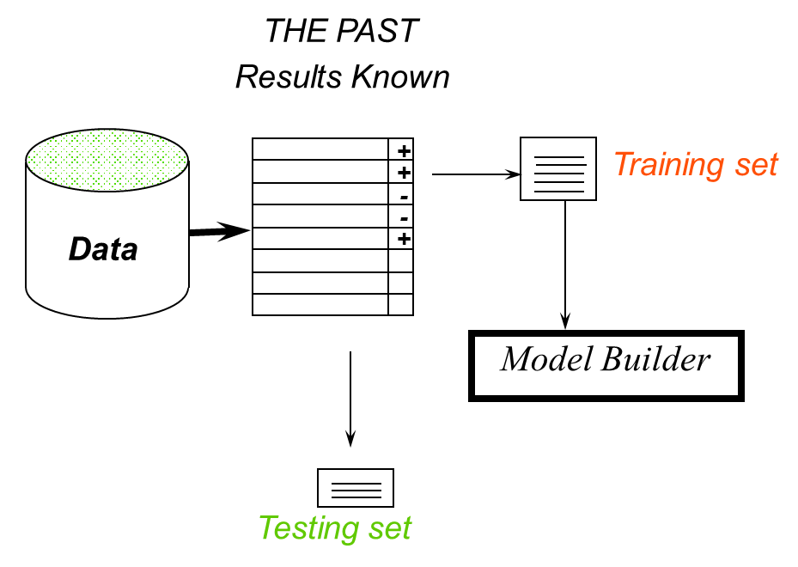
Classification Step 2: build a model on a training set

Slide 11
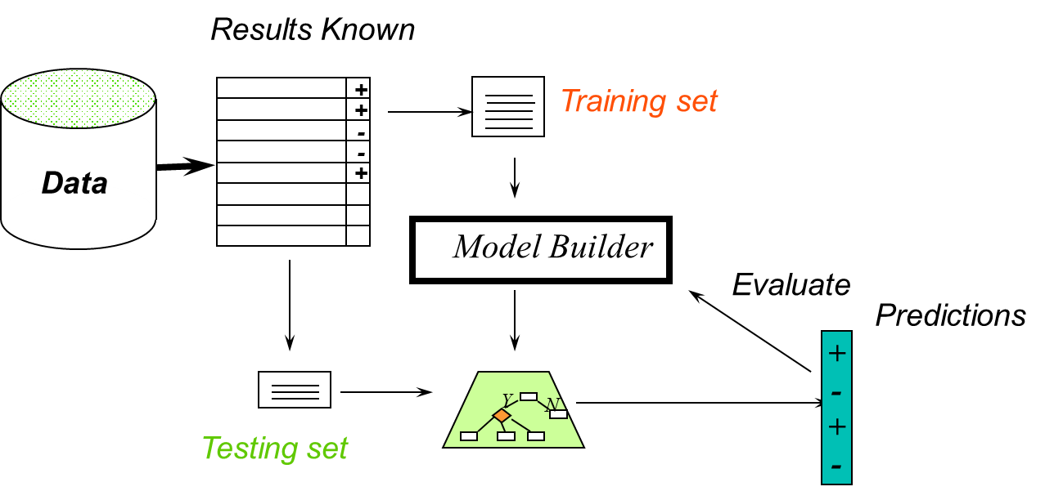
Classification Step 3: evaluate on test set

Slide 12
Handling Unbalanced Data
Sometimes classes have very unequal frequencies:
attrition prediction: 97% stay, 3% attrite (in a month)
medical diagnosis: 90% healthy, 10% diseased
eCommerce: 99% don’t buy, 1% buy
security: >99.99% of travellers are not terrorists.
Similar situation with multiple classes.
Default classifier can be 97% correct, but useless, because it is the minority class that is valuable.

Slide 13
Balancing Unbalanced Data
With two classes, one approach is to build balanced train and test sets, and train model on a balanced set
randomly select desired number of minority class instances
add equal number of randomly selected majority class
Generalize “balancing” to multiple classes
ensure that each class is represented with approximately equal proportions in train and test

Slide 14
Evaluating Balanced Models
Balancing the data will bias the classifier more towards the less frequent classes than the true distribution.
We accept the bias because the value/cost of errors depends on the class (i.e. we want to get the rare classes right more often).
Assumes that misclassification costs are exactly inverse to proportions of classes.
Balancing is simple to apply, but there are other (better) ways to do this

Slide 15
Parameter Tuning
It is important that the test data is not used in any way to create the classifier.
Many learning schemes operate in two stages:
Stage 1: builds the basic structure (including parameters, e.g. values in decision tree nodes)
Stage 2: optimizes structural parameter settings (e.g. depth of tree, number of neighbours in kNN).
The test data must not be used for tuning any parameter!
Proper procedure uses three sets: training data, validation data, and test data
Validation data is used to optimize/choose structural parameters.

Slide 16
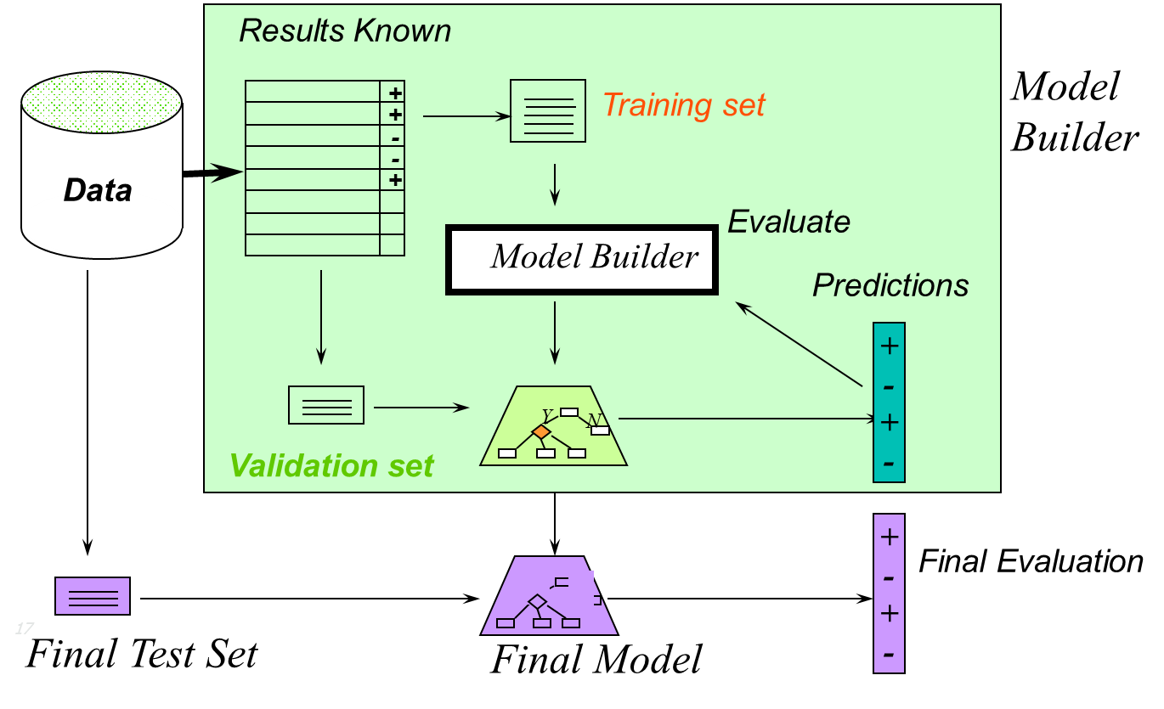
Classification: Train, Validation, Test split

Slide 17
Predicting Performance
Assume the estimated error rate is 0.25 (i.e. 25%). How close is this to the true error rate?
Depends on the amount of test data
Prediction is just like tossing a biased (!) coin.
“Head” is a “success”, “tail” is an “error”
In statistics, a succession of independent events like this is called a Bernoulli process; total number of successes follows a binomial distribution.
Statistical theory provides us with confidence intervals for the true underlying rate.

Slide 18
Confidence Intervals
People often say: true success rate p lies in a certain specified interval with a certain specified confidence c.
This is not quite precise. The correct statement is “if we ran a large number of training/evaluation experiments then a fraction c of the time the true value would lie inside a c-confidence interval”.
Example: S=750 successes on N=1000 data points
Estimated success rate: f=75%
80% confidence interval p∈[73.2,76.7]
Another example: S=75 and N=100
Estimated success rate: f=75%
With 80% confidence p∈[69.1,80.1]. What do you notice about the size of the interval?

Slide 19
Mean and Variance
Mean and variance for a Bernoulli trial: p, p (1–p)
Expected success rate f=S/N
Mean and variance for f : p, p (1–p)/N
For large enough N, f follows a Normal (Gaussian) distribution
c% confidence interval [–z ≤ X ≤ z] for random variable with 0 mean is given by:
With a symmetric distribution:

Slide 20
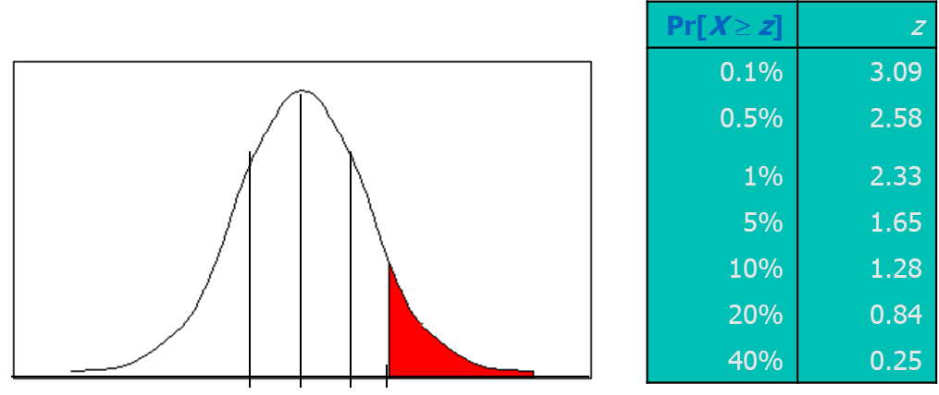
Confidence limits
Confidence limits for the normal distribution with 0 mean and a variance of 1:
To use this we have to transform the random variable f to have 0 mean and unit variance.
(Ought to use t-distribution).

Slide 21
Computing a Confidence Interval
Choose a value of c for the confidence.
Compute the standard error, SE= sqrt(f (1–f)/N).
Look up the relevant value for (100-c)/2 in the table (call this z).
The lower end of the confidence interval for p is f-z SE.
The upper end of the confidence interval for p is f+z SE.

Slide 22
Examples
f = 75%, N = 1000, c = 80% (so that z = 1.28):
f = 75%, N = 100, c = 80% (so that z = 1.28):
If we have some idea of what the true accuracy p will be, we can calculate in advance the size of test set needed to achieve a given precision in the error rate estimate.
The precision (interval width) is 2z SE, where z can be computed from the known value of c, and SE can be estimated as sqrt(p(1-p)/N). Rearranging, we can calculate N. (This should be taken as an approximation.)

Slide 23
Evaluation on small datasets
The holdout method reserves a certain amount for testing and uses the remainder for training.
For small or “unbalanced” datasets, samples might not be representative.
Stratified sample: advanced version of balancing the data.
Make sure that each class is represented with approximately equal proportions in both subsets
Holdout estimate can be made more reliable by repeating the process with different subsamples.
In each iteration, a certain proportion is randomly selected for training (possibly with stratification)
The error rates on the different iterations are averaged to yield an overall error rate
This is called the repeated holdout method.
Still not optimum: the different test sets overlap.
Can we prevent overlapping?

Slide 24
Cross-validation
Cross-validation avoids overlapping test sets
First step: data is split into k subsets of equal size
Second step: each subset in turn is used for testing and the remainder for training
This is called k-fold cross-validation.
Often the subsets are stratified before the cross-validation is performed.
The error estimates on each subset are averaged to yield an overall error estimate.
https://scikit-learn.org/stable/modules/cross_validation.html

Slide 25
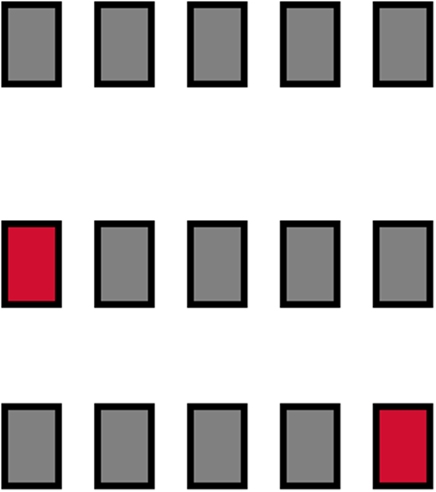
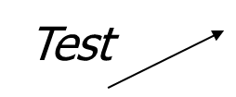
Cross-validation example
Break up data into groups of similar size
Hold aside one group for testing and use the rest to build a model
Repeat 5 times

Slide 26
Leave-One-Out Cross-Validation
Leave-One-Out: a particular form of cross-validation
Set number of folds to number of training instances i.e., for n training instances, build classifier n times
Makes best use of the data.
Involves no random subsampling.
Very computationally expensive (exception: kNN).

Slide 27

The Bootstrap
Cross-validation uses sampling without replacement
The same instance, once selected, cannot be selected again for a particular training/test set
The bootstrap uses sampling with replacement to form the training set
Sample a dataset of n instances n times with replacement to form a new dataset of n instances
Use this data as the training set
Use the instances from the original dataset that don’t occur in the new training set for testing
This gives a dataset with the same distribution as the original

Slide 28
The 0.632 bootstrap
A particular instance has a probability of 1–1/n of not being picked
Thus its probability of ending up in the test data is:
This means the training data will contain approximately 63.2% of the instances (some of which are repeated enough times to make the size up to 100%)
Combine it with the resubstitution error:

Slide 29
Comparing machine learning models
Significance tests tell us how confident we can be that there really is a difference
Null hypothesis: there is no “real” difference
Alternative hypothesis: there is a difference
A significance test measures how much evidence there is in favour of rejecting the null hypothesis
Let’s say we are using 10 times 10-fold CV
Then we want to know whether the two means of the 10 CV estimates are significantly different: use Student’s paired t-test

Slide 30
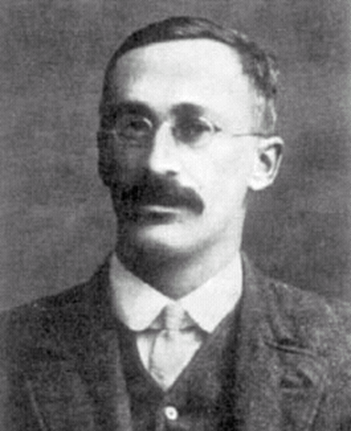
Paired t-test
Student’s t-test tells whether the means of two samples are significantly different
Take individual samples from the set of all possible cross-validation estimates
Use a paired t-test because the individual samples are paired
The same CV is applied twice
William Gossett (1876-1937)
Employed as Head Experimental Brewer at Guinness in Dublin from 1899
Invented the t-test for quality control of small samples of beer
Wrote under a pseudonym ‘Student’

Slide 31
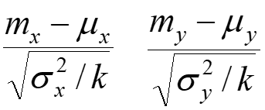
Distribution of the means
x₁ x₂ … x_{k} and y₁ y₂ … y_{k} are the 2k samples for a k-fold CV
m_{x} and m_{y} are the means
With enough samples, the mean of a set of independent samples is normally distributed
Estimated variances of the means are σ_{x}²/k and σ_{y}²/k
If μ_{x} and μ_{y} are the true means then are approximately normally distributed with mean 0, variance 1

Slide 32
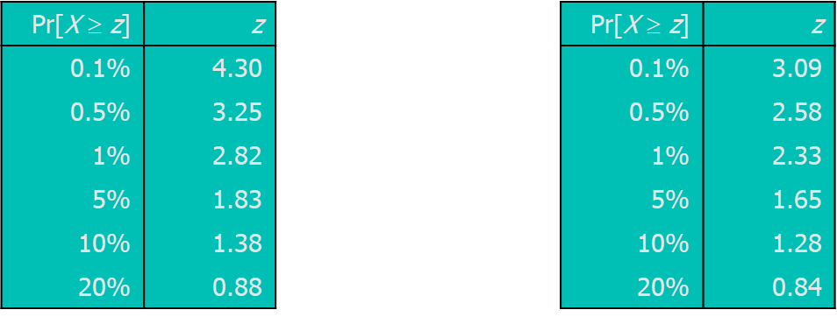
Student’s t-distribution
With small samples (k < 100) the mean follows Student’s distribution with k–1 degrees of freedom
Confidence limits:
9 degrees of freedom normal distribution

Slide 33
Distribution of the differences
Let m_{d} = m_{x} – m_{y}
The difference of the means (m_{d}) has a Student’s distribution with k–1 degrees of freedom
Let σ_{d}² be the variance of the difference
The standardized version of m_{d} is called the t-statistic:
We use t to perform the t-test

Slide 34
Performing the test
Fix a significance level α
If a difference is significant at the α% level, there is a (100-α)% chance that there really is a difference
Divide the significance level by two because the test is two-tailed
I.e. the true difference can be +ve or – ve
Look up the value for z that corresponds to α/2
If t ≤ –z or t ≥ z then the difference is significant
I.e. the null hypothesis can be rejected
https://docs.scipy.org/doc/scipy/reference/generated/scipy.stats.ttest_rel.html

Slide 35
Evaluation Summary
Use Train, Test, Validation sets for “large” data.
Use Cross-validation for small data.
Don’t use test data for parameter tuning - use separate validation data.
Most Important: Avoid Overfitting.

